Slide 1
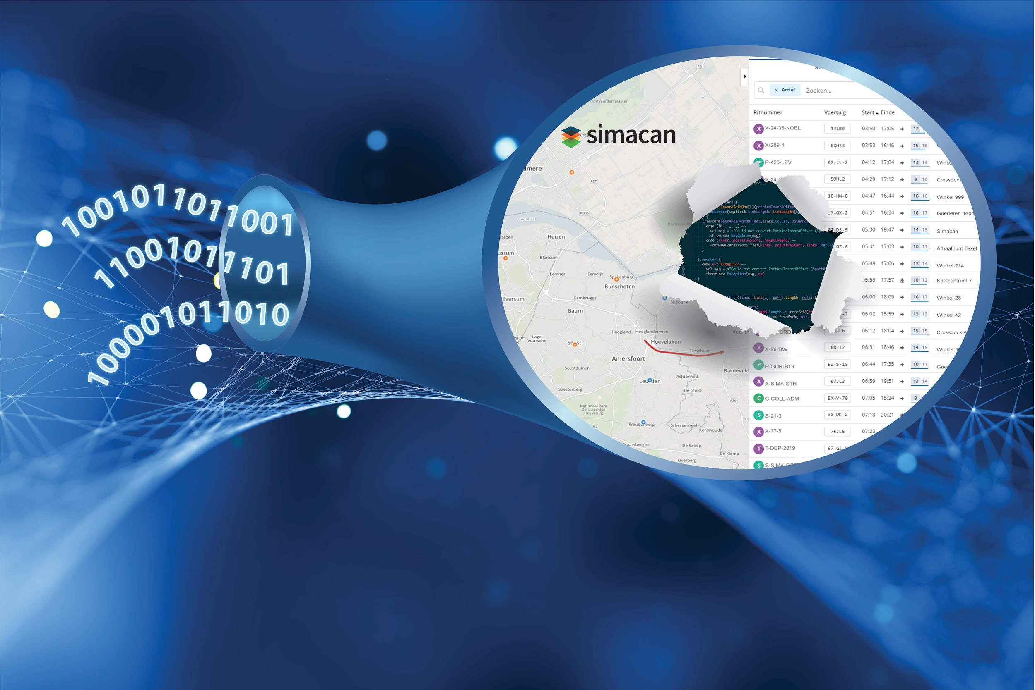
Streaming data with Kafka and Akka
JFall 2018
8 november 2018 | info@simacan.com | @simacanbv

Slide 2


‘Scale up’, 32 medewerkers
Verkeer & logistiek
Ahold, PostNL, ANWB, Jumbo, Bloomon, SPAR, ...
Streaming geo-data
Microservices
Scala
Jelle Voost

Slide 3
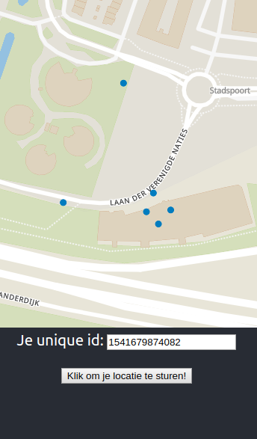


Slide 4
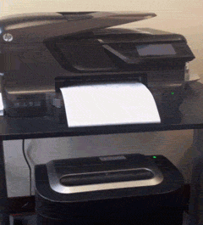
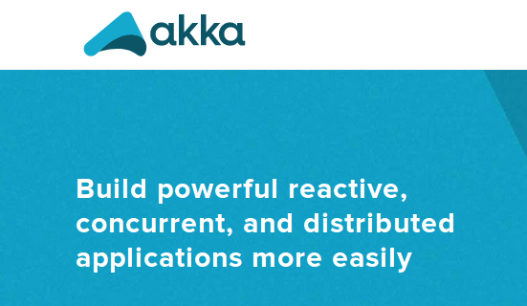
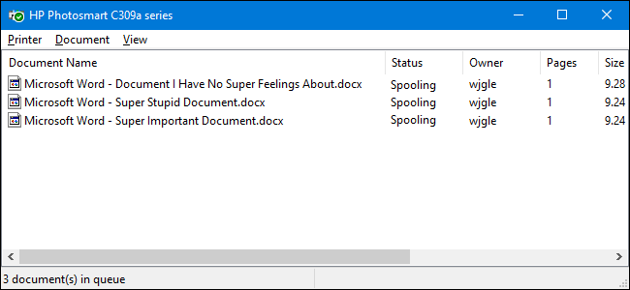


Slide 5
Akka Actor
Akka Streams
Akka Http

Slide 6
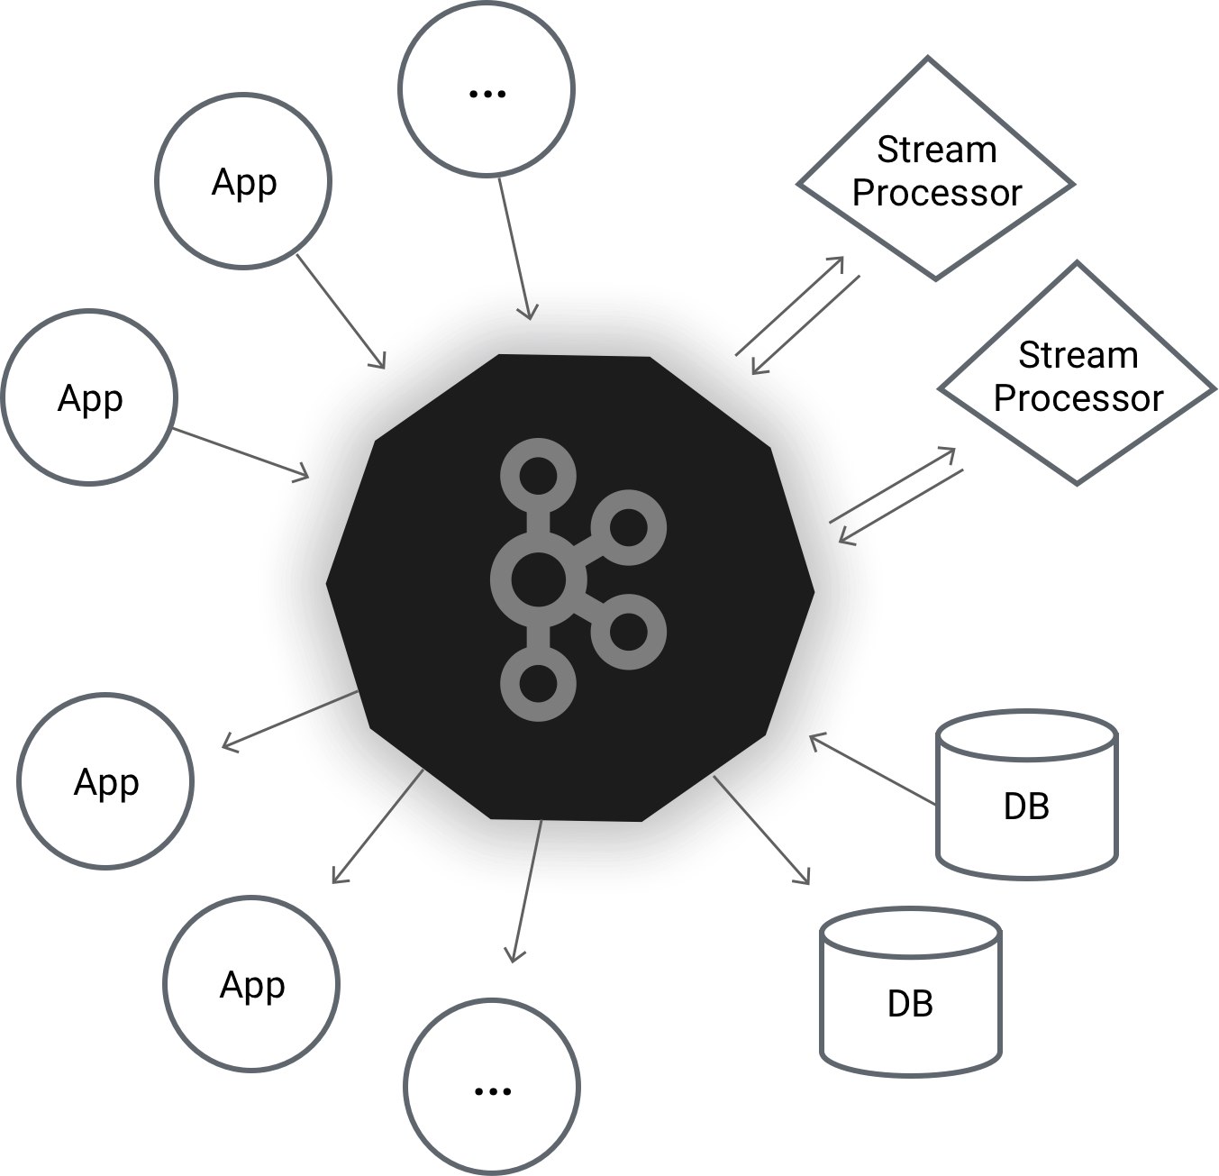

Slide 7


HTTP REST endpoint
Mini Control Tower
lat, lon

Slide 8
case class GPSUpdate(
uniqueId: String,
latitude: Double,
longitude: Double,
timestamp: Long
)
HTTP endpoint service

Slide 9
class HttpEndpointServiceApi(
producer: KafkaProducer[String, String],
kafkaTopicOut: String
) {
val route: Route =
pathPrefix("addGPSUpdate") {
post {
entity(as[GPSUpdate]) { update =>
produceItem(update)
complete(StatusCodes.OK)
}}}
def produceItem(update: GPSUpdate) = {
producer.send(
new ProducerRecord[String, String](kafkaTopicOut, Json.toJson(update))
)
}
}
HTTP endpoint service

Slide 10
object HttpEndpointService extends App {
val producerProperties = new Properties()
producerProperties.put("bootstrap.servers", "localhost:9092")
producerProperties.put("key.serializer", classOf[StringSerializer].getName)
producerProperties.put("value.serializer", classOf[StringSerializer].getName)
val producer = new KafkaProducer[String, String](producerProperties)
startServer()
def startServer() = {
val topic = "jfall-gps-updates"
val api = new HttpEndpointServiceApi(producer, topic)
Http().bindAndHandle(api.route, interface = "localhost", port = 8080)
}
}
HTTP endpoint service

Slide 11
HTTP REST endpoint
Mini Control Tower
lat, lon

Slide 12
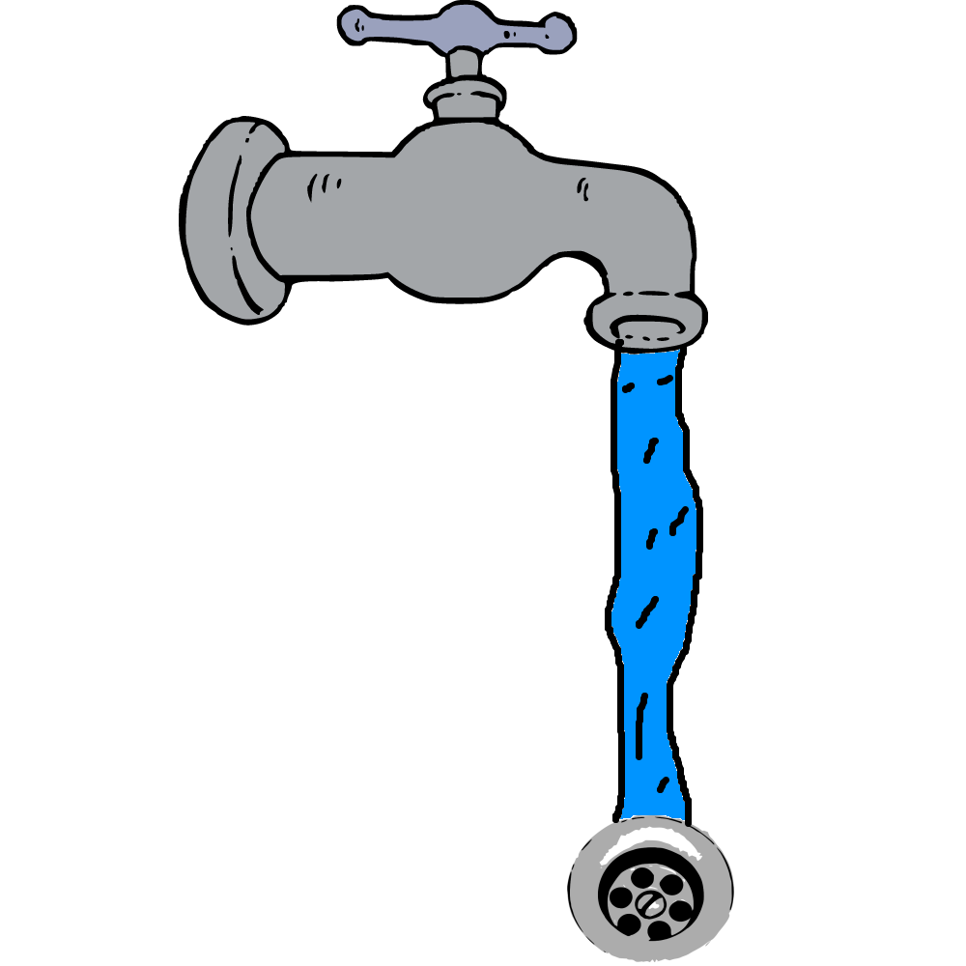
GPS Updates
Consumer
source
GPS Updates Actor
sink

Slide 13
class GPSUpdateConsumer(system: ActorSystem, topic: String) {
def source: Source[GPSUpdate, Consumer.Control] = {
val msgDsrlzr: Deserializer[GPSUpdate] = new KafkaJSONDeserializer[GPSUpdate]
val consumerSettings =
ConsumerSettings(system, new StringDeserializer, msgDsrlzr)
.withGroupId("mini-ct-consumer")
.withBootstrapServers("localhost:9092")
val subscription = Subscriptions.topics(topic)
Consumer
.plainSource(consumerSettings, subscription)
.map(consumerRecord => consumerRecord.value())
}
}
Control tower service

Slide 14
class GPSUpdatesActor extends Actor {
private var latestUpdatesMap = Map.empty[String, GPSUpdate]
override def receive: Receive = {
case gpsUpdate: GPSUpdate =>
latestUpdatesMap = latestUpdatesMap + (gpsUpdate.deviceId -> gpsUpdate)
case GetLatestUpdates => sender() ! LatestUpdates(latestUpdatesMap)
}}
object GPSUpdatesActor {
def props: Props = Props(new GPSUpdatesActor)
object GetLatestUpdates
}
Control tower service

Slide 15
object ControlTower extends App {
val topic = "jfall-gps-updates"
implicit val system: ActorSystem = ActorSystem()
val updatesActor: ActorRef = system.actorOf(GPSUpdatesActor.props)
val GPSUpdateConsumer = new GPSUpdateConsumer(system, topic)
val updatesSink = Sink.actorRef(updatesActor)
startApplication()
def startApplication() = {
GPSUpdateConsumer.source
.to(updatesSink)
.run
}
}
Control tower service

Slide 16
class ControlTowerApi(updatesActor: ActorRef) {
val route: Route = {
pathPrefix("getLatestUpdates") {
get {
implicit val timeout: Timeout = Timeout(5.second)
onComplete((updatesActor.ask(GetLatestUpdates)).mapTo[LatestUpdates]) {
case Success(value) =>
complete(StatusCodes.OK -> value)
case Failure(ex) =>
complete(StatusCodes.InternalServerError -> ex)
}
}
}
}
}
Control tower service

Slide 17
Demo!

Slide 18
Waarom?
Data
consistency
is key!

Slide 19
Akka: Single service parallelisation
Kafka: Multi service parallelisation

Slide 20
Dev = Staging = Productie
Mini Control Tower
DEV
HTTP REST endpoint
Mini Control Tower
STAGING
lat, lon
Mini Control Tower
PROD

Slide 21
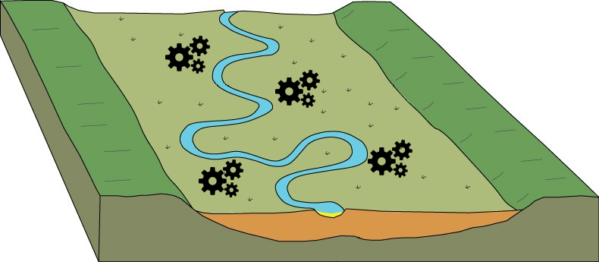
Normale dataflow

Slide 22
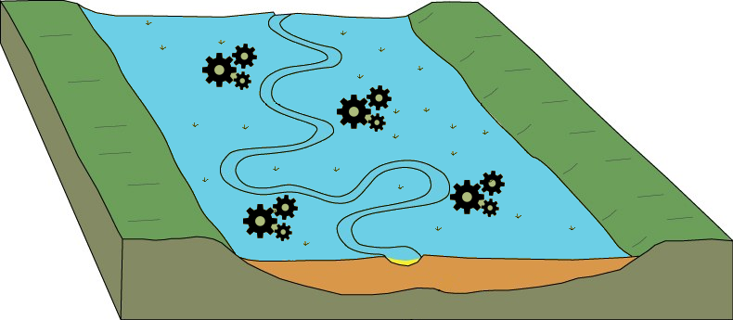
Te hoge dataflow

Slide 23
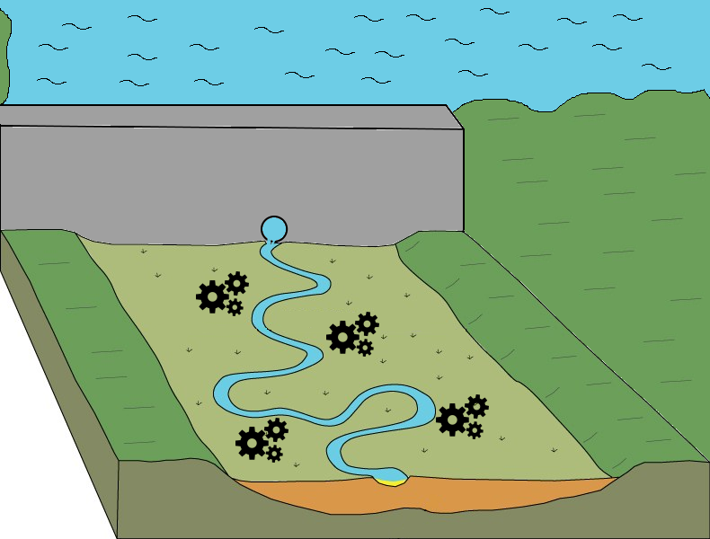

Slide 24
Demo!

Slide 25
HTTP REST endpoint
Mini Control Tower
lat, lon
Filter service
Geofence API

Slide 26
object GeofenceServer extends HttpApp {
override def routes: Route = {
path("coordinates") {
get {
parameters(('lat.as[Double], 'lon.as[Double])) {
case (lat, lon) =>
//It waits some time to be deliberately slow for the demo
Thread.sleep(100)
complete(HttpEntity(ContentTypes.`text/plain(UTF-8)`,
GeofenceTools.checkOnSquareGeofence(lat, lon)
))
}}}}}
object Main extends App {
GeofenceServer.startServer("localhost", 9000)
}
Geofence API

Slide 27
case class GeofenceClient(geofenceUri: Uri) {
def isInGeofence(lat: Double, lon: Double): Future[Boolean] = {
val getUri = geofenceUri.withQuery(
Query("lat" -> lat.toString,"lon" -> lon.toString)
)
for {
httpResponse: HttpResponse <- Http().singleRequest(HttpRequest(
uri = getUri,
method = HttpMethods.GET
))
string <- Unmarshal(httpResponse).to[String]
response <- Unmarshal(string).to[Boolean]
} yield response
}
}
Filter service

Slide 28
class GeofenceActor(geofenceClient: GeofenceClient) extends Actor {
override def receive: Receive = {
case GeofenceRequest(update) =>
val senderToReturnTo = sender()
geofenceClient.isInGeofence(update.latitude, update.longitude)
.foreach{
case true => senderToReturnTo ! true
case false => senderToReturnTo ! false
}
}
}
object GeofenceActor {
case class GeofenceRequest(gpsUpdate: GPSUpdate)
def props(client: GeofenceClient) = Props(new GeofenceActor(client))
}
Filter service

Slide 29
implicit val system: ActorSystem = ActorSystem()
val producerProperties = new Properties()
producerProperties.put("bootstrap.servers", "localhost:9092")
producerProperties.put("key.serializer", classOf[StringSerializer].getName)
producerProperties.put("value.serializer", classOf[StringSerializer].getName)
val consumerProperties = new Properties()
consumerProperties.put("bootstrap.servers", "localhost:9092")
consumerProperties.put("group.id", "filter-service-actor")
val producer = new KafkaProducer[String, String](producerProperties)
val consumer = new KafkaConsumer[String, GPSUpdate](consumerProperties, new StringDeserializer, new KafkaJSONDeserializer[GPSUpdate]())
consumer.subscribe(List("jfall-gps-updates").asJava)
val geofenceClient = GeofenceClient(Uri("http://localhost:9000/coordinates"))
val geofenceActor = system.actorOf(GeofenceActor.props(geofenceClient))
Filter service
Aanpak 1, geen backpressure 1/2

Slide 30
implicit val askTimeout: Timeout = Timeout(5 seconds)
val kafkaPollTimeout = 1000
while (true) {
val records = consumer.poll(kafkaPollTimeout)
records.forEach(record => {
val gpsUpdate = record.value()
geofenceActor.ask(GeofenceRequest(gpsUpdate)).onComplete {
case Success(true) => produceItem(gpsUpdate)
case Success(false) => println("Not in geofence")
case Failure(_) => println("Timeout occurred!")
}})}
def produceItem(loc: GPSUpdate) = {
producer.send(
new ProducerRecord[String, String]("jfall-filtered-updates", Json.toJson(loc))
)
}
Filter service
Aanpak 1, geen backpressure 2/2

Slide 31
Demo!

Slide 32
implicit val system: ActorSystem = ActorSystem()
val geofenceClient = GeofenceClient(Uri("http://localhost:9000/coordinates"))
val geofenceActor = system.actorOf(GeofenceActor.props(geofenceClient))
val consumerSettings = ConsumerSettings(system, new StringDeserializer, new StringDeserializer)
val subscription = Subscriptions.topics("jfall-gps-updates")
val updatesConsumerSource = Consumer.plainSource(consumerSettings, subscription)
val producerSink = ProducerSettings(system, new StringSerializer, new StringSerializer)
val producerSink = Producer.plainSink(producerSink)
Aanpak 2, backpressure 1/2
Filter service

Slide 33
implicit val askTimeout: Timeout = Timeout(5 seconds)
val topicOut = "jfall-filtered-updates"
val akkaStream = updatesConsumerSource
.map(record => record.value())
.alsoTo(Sink.foreach(_ => println("processing an item")))
.mapAsync(5)(location => geofenceActor.ask(
GeofenceRequest(location)).map(a => (location, a.asInstanceOf[Boolean])
))
.collect { case (update, true) => update }
.map(value => new ProducerRecord[String, String](topicOut, Json.toJson(value)))
.to(producerSink)
akkaStream.run()
Aanpak 2, backpressure 2/2
Filter service

Slide 34
Demo!

Slide 35
class GPSUpdatesActor extends Actor {
private var latestUpdatesMap = Map.empty[String, GPSUpdate]
override def receive: Receive = {
case gpsUpdate: GPSUpdate =>
latestUpdatesMap = latestUpdatesMap + (gpsUpdate.deviceId -> gpsUpdate)
case GetLatestUpdates => sender() ! LatestUpdates(latestUpdatesMap)
}}
object GPSUpdatesActor {
def props: Props = Props(new GPSUpdatesActor)
object GetLatestUpdates
}
Control tower service
Control tower zonder backpressure

Slide 36
class GPSUpdatesActor extends Actor {
private var latestUpdatesMap = Map.empty[String, GPSUpdate]
override def receive: Receive = {
case Init => sender() ! Ack
case gpsUpdate: GPSUpdate =>
latestUpdatesMap = latestUpdatesMap + (gpsUpdate.deviceId -> gpsUpdate)
sender() ! Ack
case GetLatestUpdates => sender() ! LatestUpdates(latestUpdatesMap)
}}
object GPSUpdatesActor {
def props: Props = Props(new GPSUpdatesActor)
object Ack
object Init
object Complete
object GetLatestUpdates
}
Control tower service
Control tower met backpressure
val updatesSink = Sink.actorRefWithAck(updatesActor, Init, Ack, Complete)

Slide 37
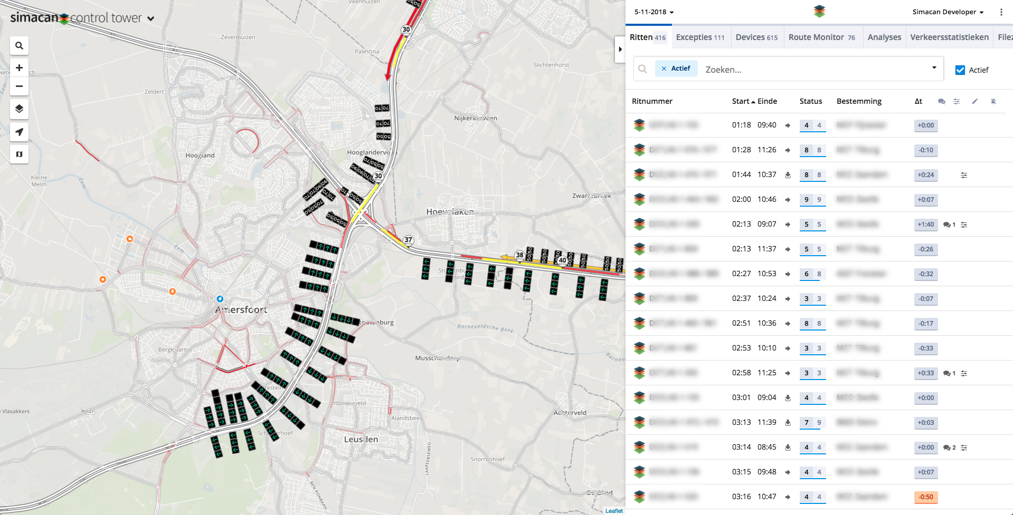

Slide 38

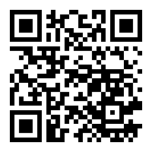

Final notes
Sources van de demo: https://github.com/simacan/jfall-2018
29 november 2018 – Pizza night: ‘Waarom we van Scala houden’ @ Simacan HQ (Amersfoort) https://www.simacan.com/scala-pizza
Simacan Nerds blog: https://www.simacan.com/nerds
Vergeet niet mijn talk te raten in de J-Fall app!

